Slide 1

Transforming E-Commerce Data into Actionable Insights: Optimizing Business Decisions and Customer Experience
Team Members:
Bassel Ashraf Ahmed
Omar Hussien Mohamed
Ahmed Tarek Mohamed
Mohamed Tarek Abdelsattar
Track: Microsoft Data Engineer
Supervisor: Moshira Galeb

Slide 2
Introduction
This project aims to build a comprehensive data engineering and analytics pipeline to process e-commerce transactions and generate valuable business insights. Leveraging Azure Data Factory, an automated pipeline was designed to ingest data from CSV files into an Azure SQL database, where it was cleaned, transformed, and stored for further analysis. The pipeline facilitates efficient querying by merging SQL tables and applies regression analysis to predict sales trends. A Power BI dashboard was created to visualize key metrics and trends, allowing the team to present actionable insights for improving business decisions. The project demonstrates the integration of cloud-based tools and machine learning techniques to drive data-driven decision-making.

Slide 3
Datasets Overview
Our analysis and pipeline were built on four core datasets that provided comprehensive information about e-commerce transactions:
Customers Table
Fields: CustomerID, Country
Description: Contains customer information, including unique customer identifiers and their associated country. This table is crucial for understanding customer demographics and segmenting sales by region.
Invoices Table
Fields: InvoiceNo, CustomerID, InvoiceDate
Description: Represents individual transactions, with each invoice linked to a customer and timestamped with the date of purchase. This table allowed us to track sales over time and associate purchases with specific customers.
InvoiceItems Table
Fields: InvoiceNo, StockCode, Quantity, TotalPrice
Description: Provides detailed information about the products within each invoice, including the product code, quantity purchased, and total price. It links invoices with the products being sold.
Products Table
Fields: StockCode, Description, UnitPrice
Description: Contains product details, including the stock code, product descriptions, and pricing information. This table enabled us to analyze the most popular products and price trends.

Slide 4
Data Cleaning Process
We applied several data cleaning steps to ensure the quality and consistency of our four datasets: Customers, Invoices, InvoiceItems, and Products. The key cleaning tasks performed are as follows:
Customers Table
Handling Missing Values: Rows with missing CustomerID were dropped to ensure accurate customer-level analysis.
Data Type Conversion: Converted CustomerID to a string to maintain consistency and prevent future issues in merging.
Invoices Table
Fixing Date Formats: Converted the InvoiceDate column to a proper datetime format to facilitate time-based analysis.
InvoiceItems Table
Removing Negative Quantities: Rows with negative quantities (representing returns) were removed to focus on actual sales.
Fixing Invalid Total Prices: Recalculated TotalPrice as the product of Quantity and UnitPrice to ensure data integrity.
Products Table
Handling Invalid Stock Codes: Removed invalid or non-numeric stock codes (e.g., POST, DOT, etc.) to eliminate non-product transactions like charges and fees.

Slide 5
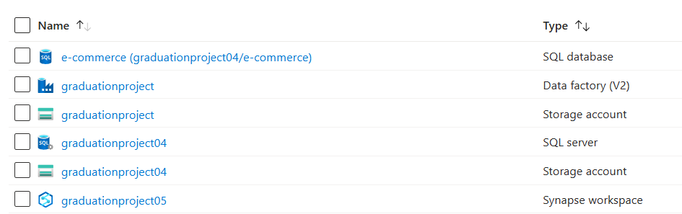
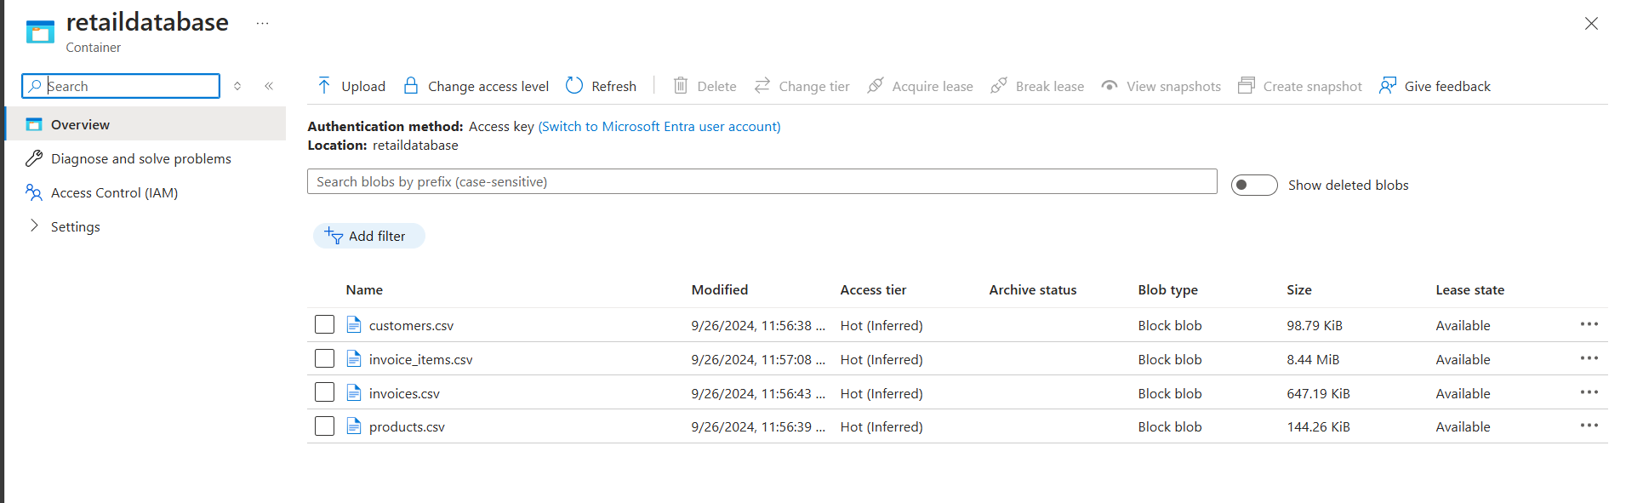
Azure Pipeline: Infrastructure Setup
To handle data ingestion and transformation, we set up the following Azure resources:
Azure Storage Account
Used for storing our four CSV datasets (Customers, Invoices, InvoiceItems, and Products) that served as the source files for the data pipeline.
Azure SQL Server & SQL Database
SQL Server: Hosted the SQL database where the cleaned and transformed data was ultimately loaded.
SQL Database: This database housed tables for each dataset (Customers, Invoices, InvoiceItems, Products) where the data was inserted after processing.
Azure Data Factory
The key orchestration tool that allowed us to automate the data flow from CSV ingestion to the SQL database. It handled data transformation, cleansing, and loading.

Slide 6
Azure Data Factory: Data Flows & Pipeline
To populate our SQL database, we designed and executed the following steps within Azure Data Factory:
Data Flows:
We created four distinct data flows for each dataset (Customers, Invoices, InvoiceItems, Products). Each flow connected to the corresponding CSV file in the Azure storage account.
Data Cleansing & Transformation: Each data flow handled necessary data cleansing steps such as data type conversions, removal of nulls, and mapping columns between the CSV files and SQL tables.
Pipeline Creation:
Pipeline Structure: A single pipeline was created to orchestrate the execution of the four data flows in sequence, ensuring that the data was inserted into the corresponding SQL tables.
Linked Services: Connected the Azure Storage Account and SQL Database, allowing seamless data movement between the source and target.
Execution Order: The pipeline ensured that data flowed correctly into the SQL database by running the Customers, Products, Invoices, and InvoiceItems flows in the right order.

Slide 7
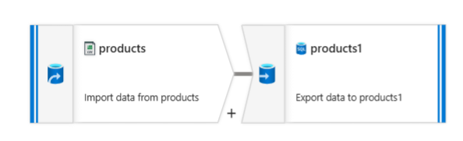
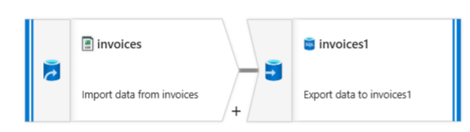
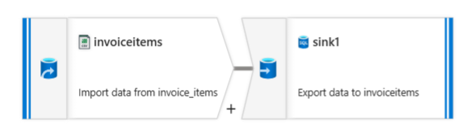
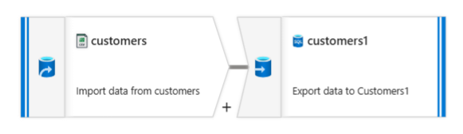
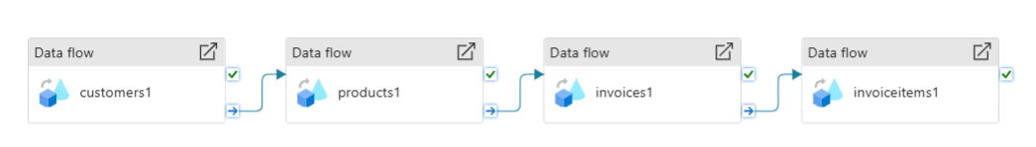
Azure Data Factory: Data Flows & Pipeline

Slide 8
SQL Querying and Analysis in Azure Data Studio
After successfully populating our SQL database using the Azure Data Factory pipeline, we utilized Azure Data Studio for querying and analysis. Our main objective was to consolidate the four datasets (Customers, Invoices, InvoiceItems, and Products) into a unified table for more efficient querying.
1.SalesSummary Table Creation
We merged the Customers, Invoices, InvoiceItems, and Products tables into a single comprehensive table called SalesSummary. This table consolidated customer information, product details, invoice data, and total sales, allowing for streamlined queries.

Slide 9
SQL Querying and Analysis in Azure Data Studio
CREATE TABLE SalesSummary (
CustomerID INT,Country VARCHAR(100),
InvoiceNo INT,
InvoiceDate DATETIME,
StockCode VARCHAR(100),
Description VARCHAR(255),
UnitPrice DECIMAL(10, 2),
Quantity INT,
TotalPrice DECIMAL(10, 2),
TotalItemPrice AS (Quantity * UnitPrice)
);
INSERT INTO SalesSummary (CustomerID, Country, InvoiceNo, InvoiceDate, StockCode,
Description, UnitPrice, Quantity, TotalPrice)
SELECT
c.CustomerID,
c.Country,
i.InvoiceNo,
i.InvoiceDate,
ii.StockCode,
p.Description,
p.UnitPrice,
ii.Quantity,
ii.TotalPrice
FROM dbo.Customers AS c
JOIN dbo.Invoices AS i ON c.CustomerID = i.CustomerIDJOIN dbo.InvoiceItems AS ii ON i.InvoiceNo = ii.InvoiceNo
JOIN dbo.Products AS p ON ii.StockCode = p.StockCode;

Slide 10
SQL Querying and Analysis in Azure Data Studio
2. Key Queries Performed
Total Sales per Customer
This query aggregated the total sales for each customer, giving insights into the highest-value customers and their regions.
Top-Selling Products
We identified the best-selling products by aggregating the quantity sold for each product description.
Invoices within a Specific Date Range
This query retrieved the total value of invoices for a given time frame, providing insights into sales trends over specific periods.

Slide 11
SQL Querying and Analysis in Azure Data Studio
SELECT CustomerID, Country, SUM(TotalItemPrice) AS TotalSales
FROM SalesSummary
GROUP BY CustomerID, Country;
SELECT StockCode, Description, SUM(Quantity) AS TotalQuantitySold ​
FROM SalesSummary ​
GROUP BY StockCode, Description ​
ORDER BY TotalQuantitySold DESC;​
​
SELECT InvoiceNo, InvoiceDate, CustomerID, Country, SUM(TotalItemPrice) AS
TotalInvoiceAmount
FROM SalesSummary
WHERE InvoiceDate BETWEEN '2011-11-01' AND '2011-11-30'
GROUP BY InvoiceNo, InvoiceDate, CustomerID, Country;

Slide 12




Exploratory Data Analysis - Unveiling Key Business Insights Through Data Exploration
We conducted an exploratory data analysis to uncover patterns and trends in customer behavior, product performance, and overall sales. This analysis will inform strategic decision-making in marketing, inventory management, and product development.
Four Key Areas:
Market Analysis: Top 10 Countries by Number of Transactions
Product Performance: Top 10 Most Sold Products
Sales Trends: Monthly Sales Trend
Pricing Insights: Distribution of Total Price

Slide 13
Key Findings and Actionable Insights
Market Analysis: "The UK dominates sales, with 89% of all transactions. This highlights the importance of the UK market and suggests opportunities for targeted campaigns and promotions. Other European markets like Germany and France also show potential."
Product Performance: "'PAPER CRAFT, LITTLE BIRDIE' leads sales, indicating high demand for this product category. Understanding top performers guides inventory decisions and new product development. Party and event supplies also perform well, suggesting an opportunity for themed promotions and bundles."
Sales Trends: "Sales show an upward trend, with a peak in November, likely due to holiday shopping. Analyze factors influencing sales in other months to optimize marketing and inventory strategies."
Pricing Insights: "Most transactions are for lower-priced items. This suggests potential for increasing average order value through upselling, bundling, or promotions featuring higher-value products."
These data-driven insights provide a strong foundation for enhancing market penetration, optimizing product offerings, and maximizing revenue growth.

Slide 14
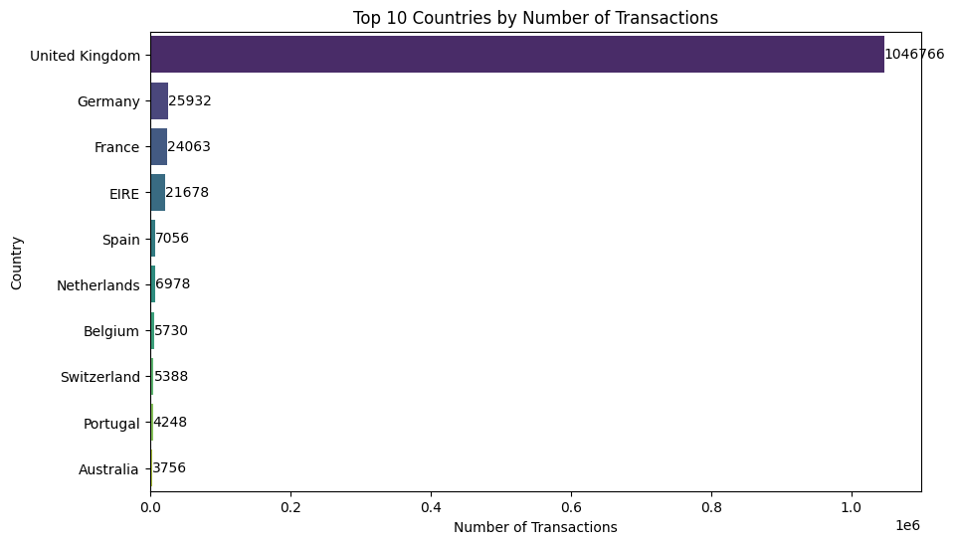
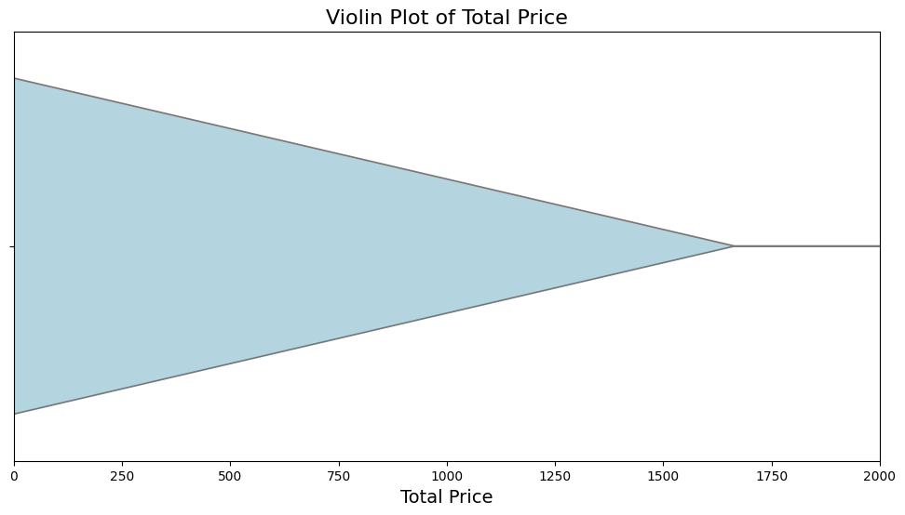
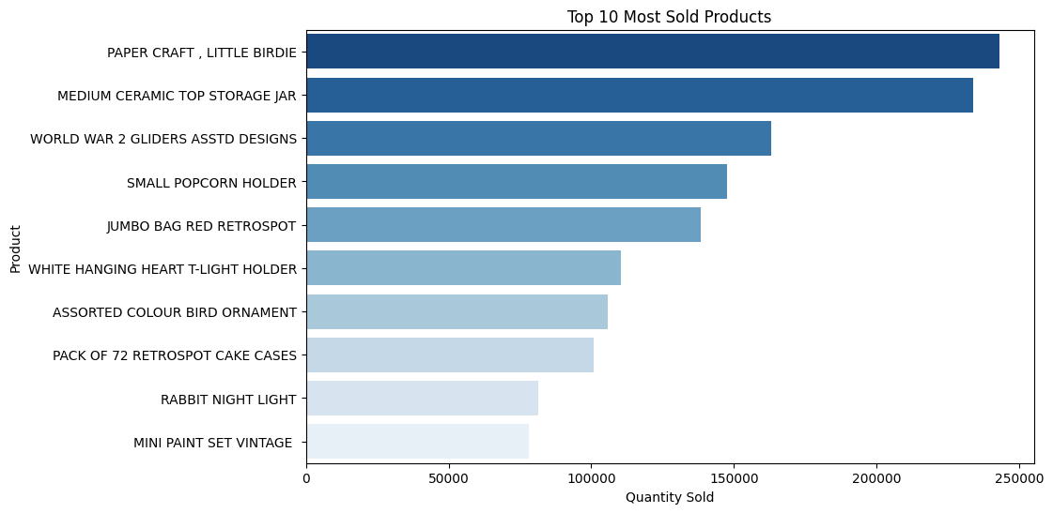
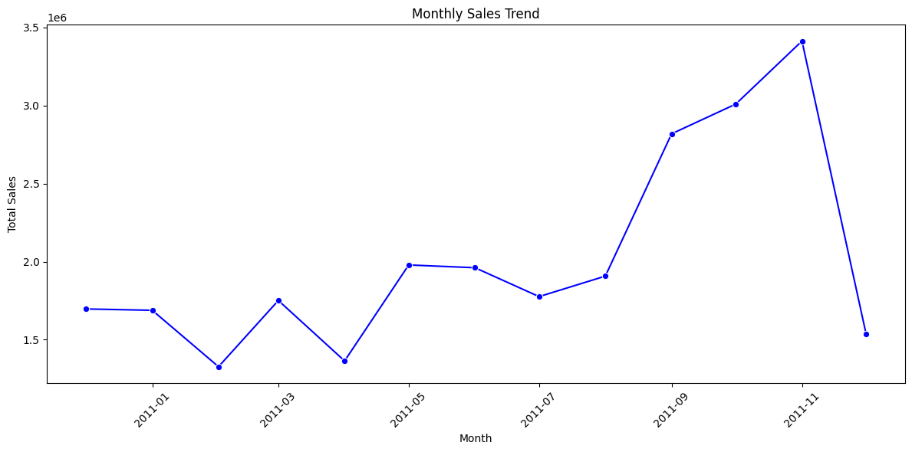
Key Findings and Actionable Insights

Slide 15
Key Sales Insights from Power BI Dashboard
Customer Base: The UK accounts for 92.7% of customers, highlighting its importance as a primary market. Other European countries contribute smaller percentages.
Top Products: "Regency Cakestand 3 Tier" and "White Hanging Heart T-Light Holder" are top sellers, driving a significant portion of revenue.
Sales Performance: Total sales reached £26.23M, with an average unit price of £2.91. Sales peaked in November, likely due to holiday shopping.

Slide 16
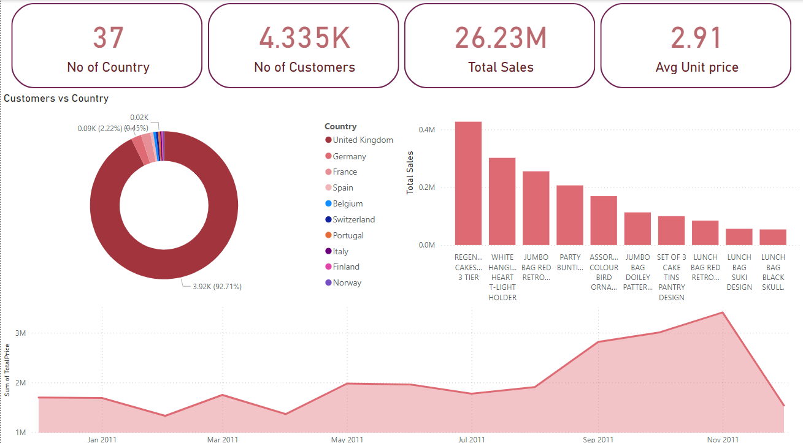
Key Sales Insights from Power BI Dashboard

Slide 17
Machine Learning Overview
Libraries Used
NumPy: Fundamental package for numerical computations.
Pandas: Data manipulation and analysis.
Scikit-Learn: Machine learning library for Python.
Key Imports
Data Splitting: train_test_split from sklearn.model_selection
Data Scaling: StandardScaler from sklearn.preprocessing
Modeling: SVC (Support Vector Classifier) from sklearn.svm
Evaluation: accuracy_score from sklearn.metrics

Slide 18
Machine Learning Overview
Workflow
Data Loading: Load the dataset.
Data Splitting: Split the dataset into training and testing sets.
Data Scaling: Standardize features by removing the mean and scaling to unit variance.
Model Training: Train a Support Vector Classifier (SVC).
Model Evaluation: Evaluate the model using accuracy score.

Slide 19
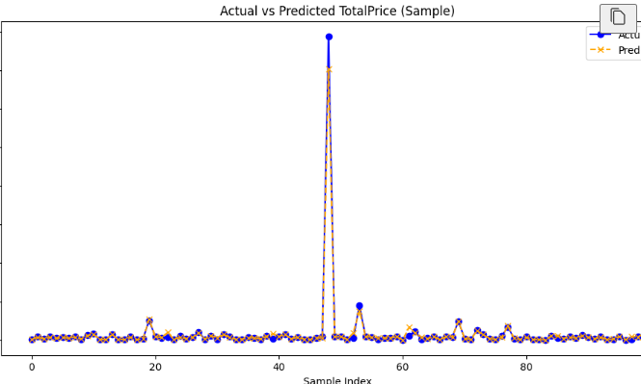

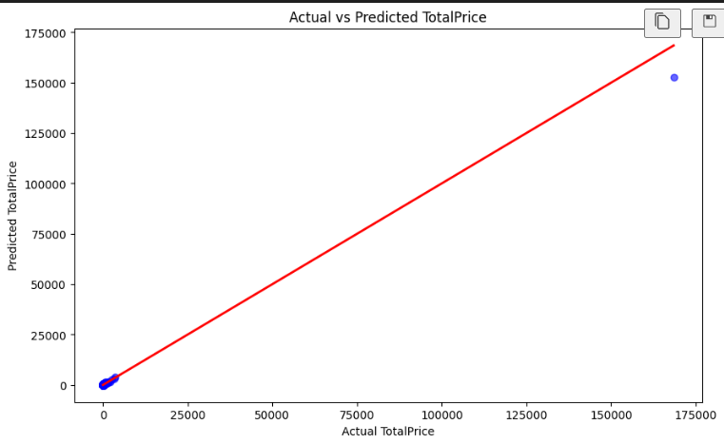
visualization of ML

Slide 20
Project Success: Data-Driven Insights for Business Growth
Key Takeaways:
Successfully implemented an Azure data pipeline for seamless data integration and transformation.
Leveraged advanced analytics (regression analysis) and visualization (Power BI) to extract actionable insights.
Empowered data-driven decision-making for improved business outcomes.

Slide 21
Thank You

